Slide 1

Database Management Systems (CS 564)
Fall 2017
Lecture 1

Slide 2
Introduction
So you ask “why”?

Slide 3
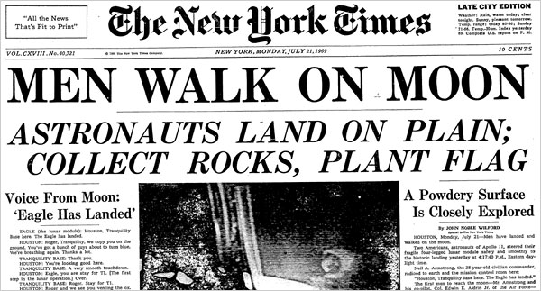
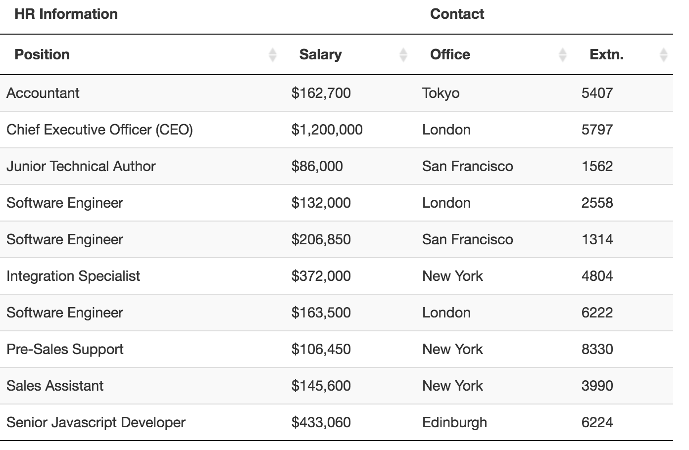
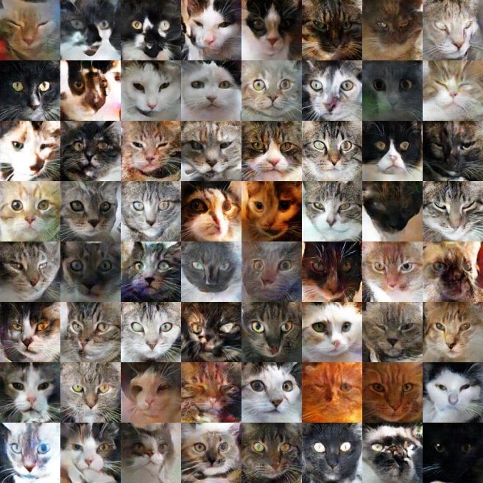
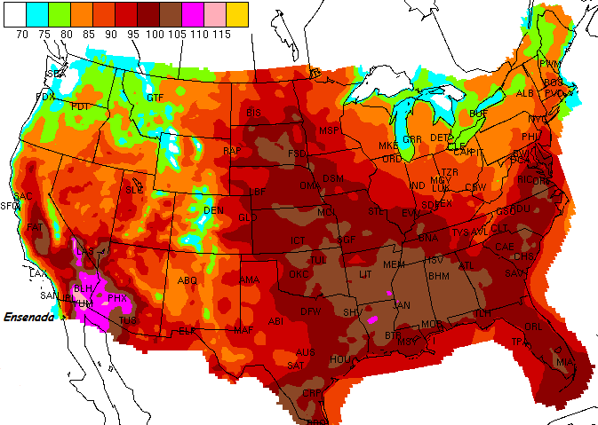
What is Data?
Oxford Dictionary entry:
Data [/ˈdeɪtə/] [mass noun]: Facts and statistics collected together for reference or analysis.
Comes in many forms and flavors
Facts
statistics
collected
reference
analysis
Database Management Systems

Slide 4








Data is Important!
“Data is the future.”
It is everywhere:
Scientific discoveries
Online services (social networks, online retailers)
Decision making
- Chris’ cab driver in Pittsburgh
Database Management Systems

Slide 5
Data is Important!
“Data is the future.”
It is everywhere:
Scientific discoveries
Online services (social networks, online retailers)
Decision making
Users organize their data as databases.
- Chris’ cab driver in Pittsburgh
Database Management Systems
Data Information Knowledge Wisdom

Slide 6
Database
A logically coherent collection of related data, representing some aspect(s) of the real world
Designed, built, and populated with data
for a specific purpose
for an intended group of users and
for some preconceived applications in which these users are interested
Database Management Systems

Slide 7
Sample Database
Student
SID | Name | Age | Major
17 | Smith | 21 | CS
8 | Brown | 24 | MATH
GradeReport
SID | SecID | Grade
17 | 30098 | A
17 | 40026 | AB
8 | 1005 | A
8 | 40026 | C
8 | 20006 | A
8 | 30098 | B
Course
CID | Name | Credits | Department
CS564 | Database Management Systems | 3 | CS
MATH240 | Discrete Mathematics | 4 | MATH
CS367 | Intro to Data Structures | 3 | CS
CS764 | Adv. Database Management | 3 | CS
Database Management Systems
Prerequisite
Section
CID | PrereqID
CS564 | CS367
CS764 | CS564
CS564 | MATH240
SecID | CID | Semester | Year | Instructor
30098 | MATH240 | Fall | 2017 | Euclid
40026 | CS367 | Fall | 2016 | Dijkstra
1005 | CS367 | Spring | 2004 | Gauss
30451 | CS764 | Fall | 2017 | Patel
20006 | CS564 | Spring | 2001 | Codd
Users: students, staff, HR
Applications: MyUW, Payroll

Slide 8
Database Management System (DBMS)
A collection of programs that enables users to create and maintain databases
A general-purpose software system that facilitates the processes of
defining
constructing
manipulating, and
sharing
databases among various users and applications, allowing data to persist over long periods of time
Factors out
common computations
on data
Database Management Systems

Slide 9
Database Management System
App 1
(web)
DB 2
DB 1
App 2
(mobile)
DB 3
App 3
(PC)

Slide 10







Examples of DBMSs
SQL Server, Microsoft Access (Microsoft)
DB2 (IBM)
Oracle
MySQL, PostgreSQL, SQLite

Slide 11
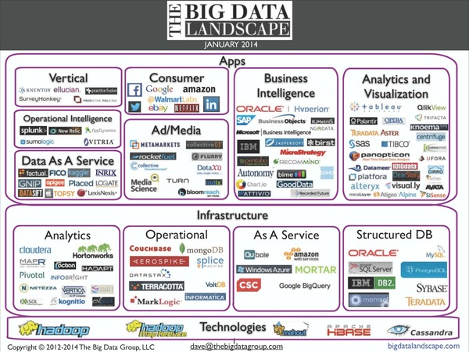
Among structured DBMSs, we focus on a specific class, called relational DBMSs.

Slide 12
Relational Database Management Systems (RDBMSs)
Their central concept is relation which is a mathematical construct.
Essentially, a relation could be viewed as a table.
Since the 1970s, RDBMSs have been studied extensively and are the most widely used DBMSs today.
Student
SID | Name | Age | Major
17 | Smith | 21 | CS
8 | Brown | 24 | MATH

Slide 13
This Class
We will learn
how to design a relational database
how to store it in an RDBMS
how to use an RDBMS
some of the internals of RDBMSs
We will NOT cover
gory details on how a DBMS works (take CS 764!)
newer types of data and how to manage them (take CS 774!)
the theory behind databases (take CS 784!)
how to be a DBA or how to tune Oracle 12g

Slide 14
Course Logistics
Or how to thrive in this noble effort

Slide 15
Course Prerequisites
Data structures and algorithm background necessary
CS 367 is a must
For the projects
Programming-heavy
C++ will be used for the database internals

Slide 16
Course Format
Lectures: Wed + Fri, 2:30-3:45PM
Slides will be posted on the course web site (https://adelaneh.github.io/cs564_fall17)
Acknowledging great notes of AnHai Doan, Paris Koutris, Christopher Re and Arun Kumar
Project: groups of three people
Multiple stages, submit some work at the end of each stage, might have a final demo
Exams: midterm and final

Slide 17
Course Staff
Lecturer: Adel Ardalan (adel@cs.wisc.edu)
Office hours
Time: Mon 2:30-3:30PM and Wed 4:00-5:00PM
Place: my office (room 4351, CS building)
TAs:
Nafisah Islam (nafisah@cs.wisc.edu)
Office hours: see course website
Varun Naik (vnaik@wisc.edu)
Office hours: see course website

Slide 18
About Me
Education
Undergrad: University of Tehran, Iran
Grad: UW-Madison
Research interests
Data integration, cleaning and analytics
Computational methods in healthcare, neuroscience and climatology
http://cs.wisc.edu/~adel

Slide 19



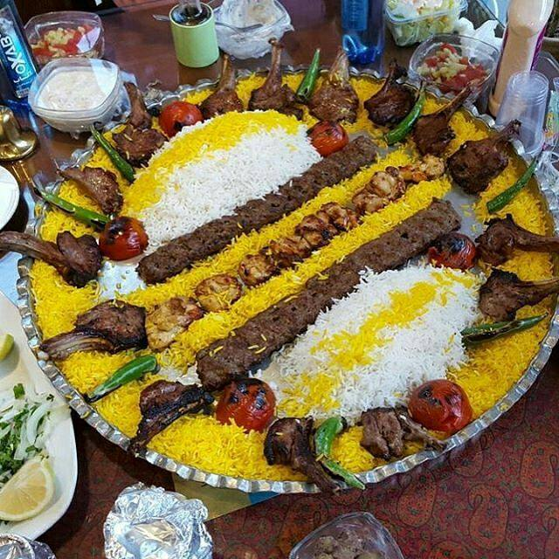
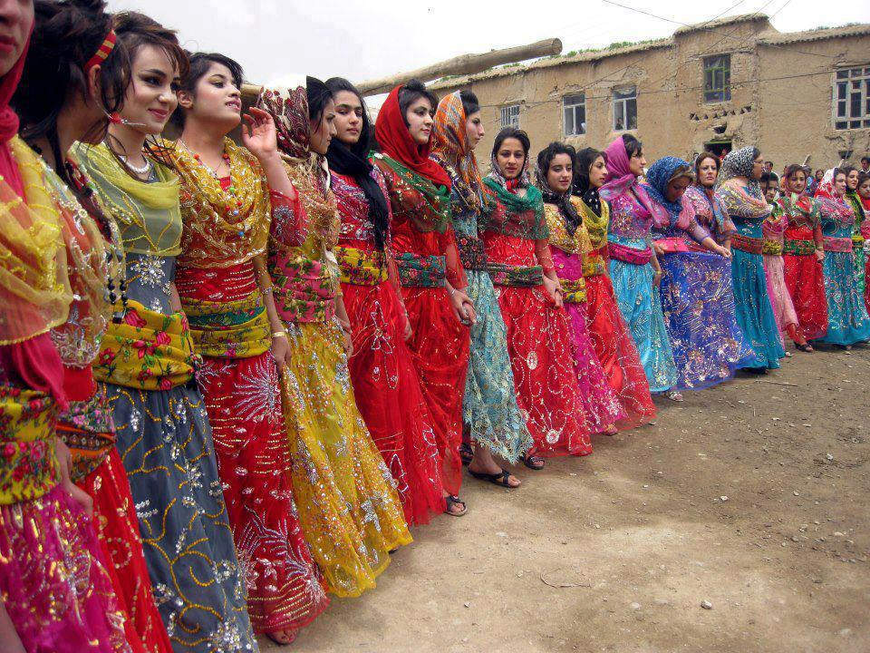
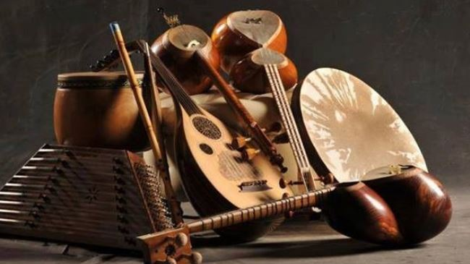

Slide 20

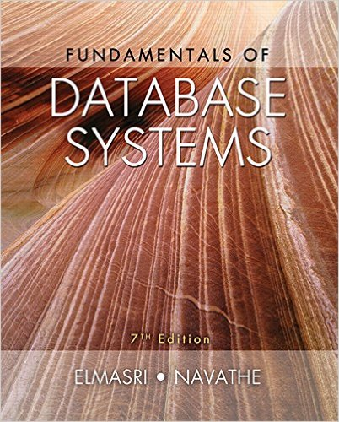
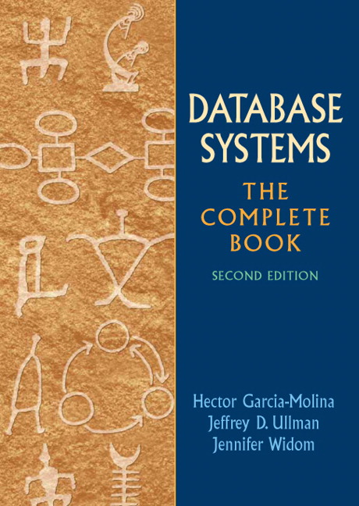
Textbook
Database Management Systems, 3rd edition, by R. Ramakrishnan and J. Gehrke (cow book)
Other sources
Fundamentals of Database Systems, 7th edition, by R. Elmasri and S. B. Navathe
Database Systems: The Complete Book, 2nd edition, by H. Garcia-Molina, J. D. Ullman and J. Widom (complete book)
Come to class!

Slide 21
Grading
Project: 40% (6 stages)
No late submissions
Stage 0 will be released today and is due in one week!
Midterm: 25%
Final: 35%
Cumulative

Slide 22
Exams
Midterm
Date: Oct. 18, 2017
Time: 2:30-3:45 PM
Place: In class
Material included: TBA
Final
Date: Dec. 20, 2017
Time: 5:05-7:05 PM
Place: TBA
Material included: TBA

Slide 23
Communication
Course web site
https://adelaneh.github.io/cs564_fall17
All the logistics information, lecture slides, up-to-date announcements and deadlines, and more!
Check the web site at least once a week!
Mailing list
compsci564-2-f17@lists.wisc.edu
Piazza
Find “CS 564-002: Database Management Systems”
Canvas
To submit project work

Slide 24
Communication (Cont.)
Participate in class discussions and use the Piazza page
Do not use email as primary communication mechanism for doubts/questions; instead post on Piazza or come to office hours
If you definitely have to email, then use “[CS 564]” as subject prefix for all emails to me/TAs
Rein in your social media activities during lectures

Slide 25
Policy on Asking Questions
There are no stupid/trivial/unimportant questions!
So
Raise your hand and ask questions in class
If you are still confused or not convinced, then study the material and ask again, from your classmates, TAs or me (in that order) on Piazza
If still not there, read additional material and ask for references. There are very resourceful and knowledgeable faculty and grad students in this department and around the globe!
Do NOT give up!

Slide 26
Code of Academic Conduct
Your responsibility to read it and oblige by it
https://docs.legis.wisconsin.gov/code/admin_code/uws/14.pdf
Alright, now back to the fun stuff!

Slide 27
Course Overview
Decades of research and development on fast-forward

Slide 28
Why Databases?
Example application: sort a list of 1000 numbers
e.g. 25, 3, 4, 1, 90, 2334, -1, 2, 3, …
Simple solution:
Write a program to sort a list of numbers and store the program in a file (e.g. in Python)
Store the list of 1000 numbers (i.e. the data) in another file
Load the program and the data into memory
Run the program on the data
Basically using file systems for data management

Slide 29
Why Databases? (Cont.)
But what if:
we want to sort a billion numbers?
many users want to sort the same list of numbers?
some users should not see the numbers other users sort?
Databases and our questions about them are often more complicated than a list of numbers and simple sorting
DBMSs take care of the above issues and many more

Slide 30
What Can a DBMS Do? (Abbr.)
Storage management
Schema management
Query and update data
Concurrency control
Crash recovery

Slide 31
Storage Management
Data outlives applications.
Persistent data: data stored for a long period of time
On tape, HDD or SSD
Large amounts of data (100s of GB or TB)
Manages the storage hierarchy (e.g. disk/RAM/cache)
User authorization
Who can access which data?
Protection from system crashes
What?!!

Slide 32
How to Describe Data
Data model: a collection of concepts for describing data
Relational data model is the most widely used today
Main concepts: relation, tuple, attribute, domain
Schema: a description of a particular collection of data, using the given data model
e.g. every relation in a relational data model has a schema describing types, etc.

Slide 33


Example of a Relational Schema
Student
Relation
SID | Name | Age | Major
17 | Smith | 21 | CS
8 | Brown | 24 | MATH
Tuple
Student(SID: int, Name: string, Age: int, Major: string)
Attribute
Domain
Course
CID | Name | Credits | Department
CS564 | Database Management Systems | 3 | CS
MATH240 | Discrete Mathematics | 4 | MATH
CS367 | Intro to Data Structures | 3 | CS
CS764 | Adv. Database Management | 3 | CS
Course(CID: string, Name: string, Credits: int, Department: string)

Slide 34
Schema Management
Describing the data by defining relations, etc.
Changing the schema
e.g. need to add DateOfBirth to the Student table

Slide 35
Data Independence
One of the most important reasons to use DBMSs
Applications do not change when the underlying structure or storage changes
Physical data independence: protection from physical layout changes
e.g. moving the data from disk to SSD
Logical data independence: protection from changes in the logical structure of the data
e.g. adding a new attribute to a table

Slide 36
Query and Update Data
Provide a high-level, declarative language to retrieve and modify data
Structured Query Language (SQL)
Example
A query processor figures out how to answer the queries efficiently.
SELECT C.Name
FROM Course C, Section S
WHERE S.Semester = “Fall” AND
S.Year = “2017” AND
C.CID= S.CID

Slide 37
Query Processor
Has two essential components:
Query optimizer: finds the best imperative execution plan for a given query
Query executor: executes the query execution plan as efficiently as possible

Slide 38
Concurrency Control
Suppose 1000s of students and staff want to query and update the data at the same time
Concurrency can lead to update problems
e.g. a TA enters the wrong grade and before he or she corrects it, the student reads the grade and freaks out!
DBMSs use transaction and enforce ACID properties.
Atomicity: all or nothing transactions
Consistency: from one valid state to another
Isolation: transactions are independent
Durability: committed data is never lost

Slide 39
Crash Recovery
How do we make sure no data is lost after the system has crashed?
e.g. disk failure or power failure
DBMSs use mechanisms such as logging and checkpoints.

Slide 40
DBMSs Rock!
Automate a lot of boring operations on data
Don’t have to program over and over
Can write complex data manipulations in just a few lines
Make execution very fast
Scales up to very large data sets
Make concurrent access/modification possible
Many users can use the data at the same time

Slide 41
Who is Involved?
DB application developer: writes programs that query and modify data
DB designer: establishes schema
DB administrator: loads data, tunes system, keeps the system running
Data analyst: does data mining, data integration
DBMS implementer: builds the DBMS

Slide 42
Recommended Read
Chapter 1 of the complete book

Slide 43
Entity-Relationship Model for Conceptual Design
Next Up
Questions?

